Slide 1
Wikibase: an open source and free tool to build your linked open knowledge base
ENDORSE Follow-up
November 16th, 2021
Georgina Burnett
swe_partnerships@wikimedia.de

Slide 2

Wikimedia Deutschland
We are a non-profit organisation based in Berlin. We are the German chapter of the global Wikimedia Movement.
We work on a number of projects and initiatives, all aimed at providing more people with more access to more knowledge.
Georgina Burnett
swe_partnerships@wikimedia.de

Slide 3


Software development department
We have a dedicated software development department. Our role is to create innovative and useful open source software that helps to provides more people with more access to more knowledge.
Georgina Burnett
swe_partnerships@wikimedia.de

Slide 4
Let’s start at the beginning: What is Wikidata?

Slide 5
Wikidata: the basics
Wikimedia project started in 2012
Free and open knowledge base
Contains structured data
Linked to other databases
Data available under CC0 licence
Based on statements and references
Made for humans and machines
Multilingual
Collaborative
Georgina Burnett
swe_partnerships@wikimedia.de

Slide 6
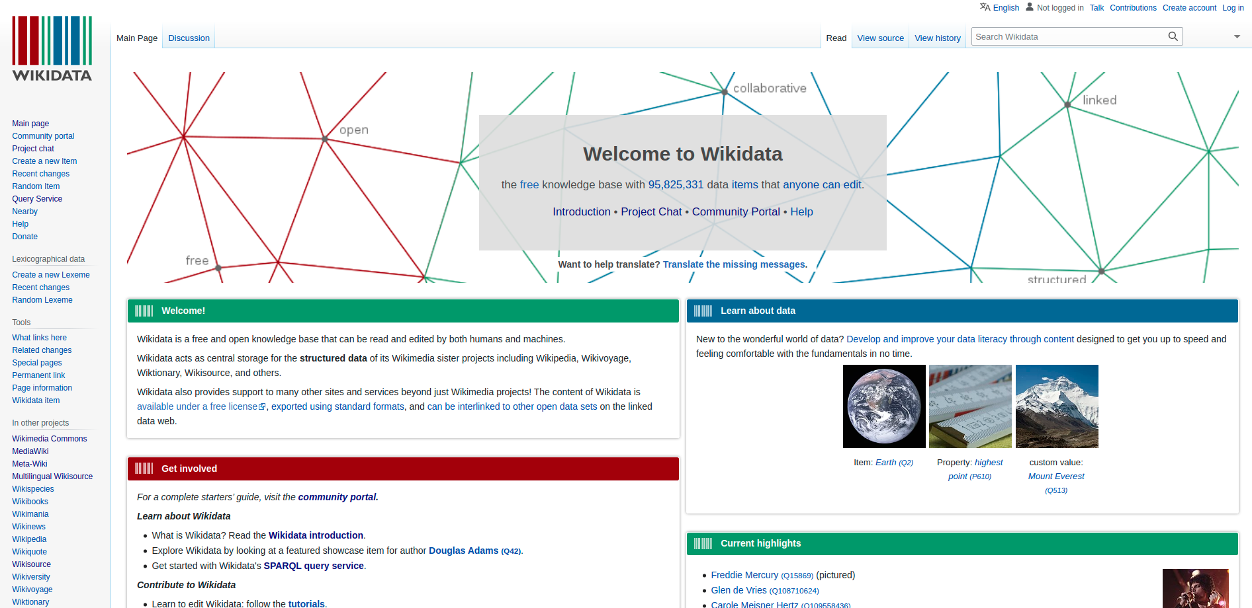
Wikidata: the basics
Georgina Burnett
swe_partnerships@wikimedia.de
Notes:
Around 25,000 active editors (with more than 1 edit per month)

Slide 7
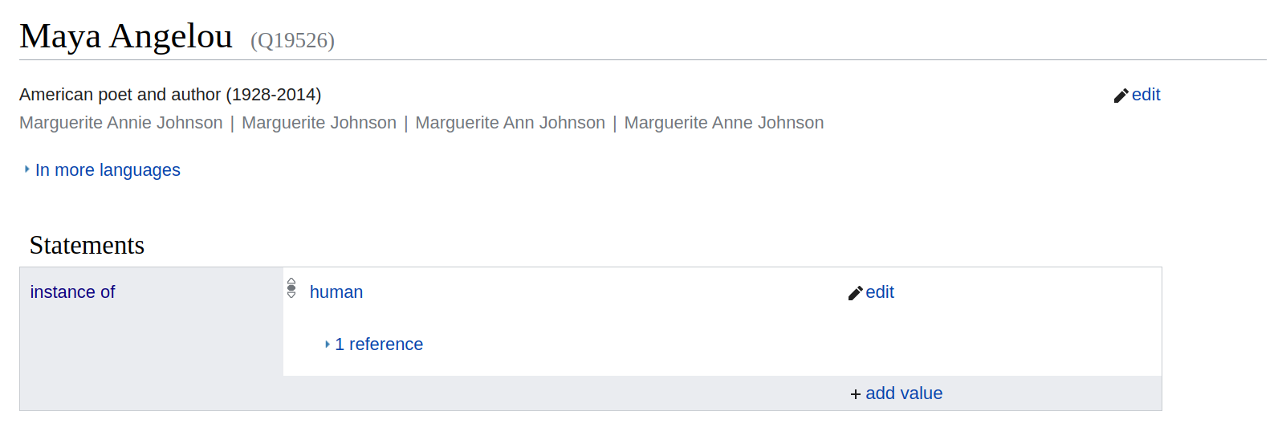
How is data modeled?
Users model the world in terms of “triples”. Triple structure: Item, Property, Value
Item identifier (Q item)
Property
Value
Georgina Burnett
swe_partnerships@wikimedia.de

Slide 8

How is data modeled?
Adding extra detail beyond the triple structure: qualifiers and references
Value
Qualifier
Property
Reference
Georgina Burnett
swe_partnerships@wikimedia.de

Slide 9
How is data modeled?
Linking data: items are linked to each other
National Women’s Hall of Fame
(Q1967852)
St. Louis (Q38022)
{Place of birth}
{Award received}
Maya Angelou (Q19526)
{Instance of}
Human (Q5)
Paul du Feu (Q97516507)
{Spouse}
Georgina Burnett
swe_partnerships@wikimedia.de

Slide 10
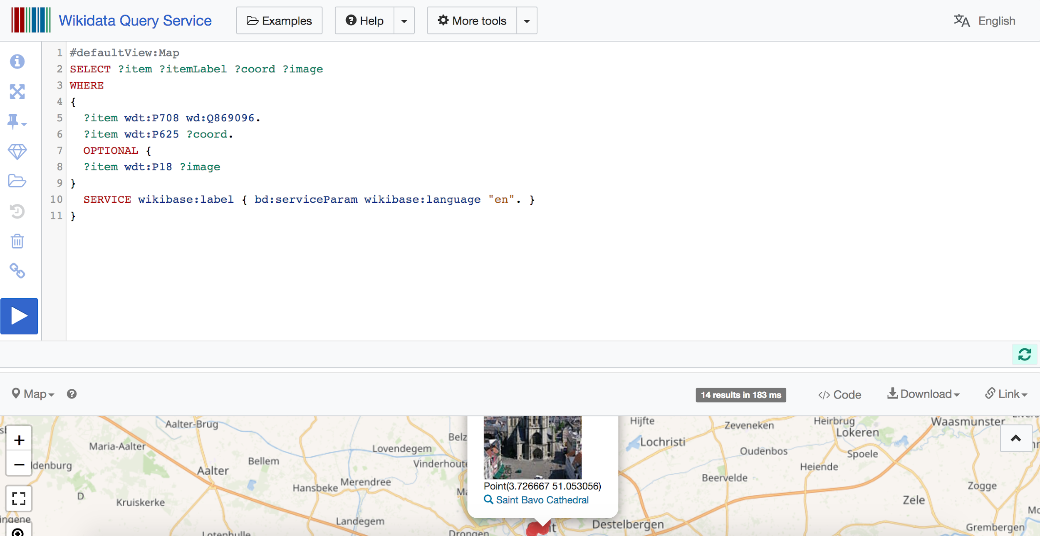
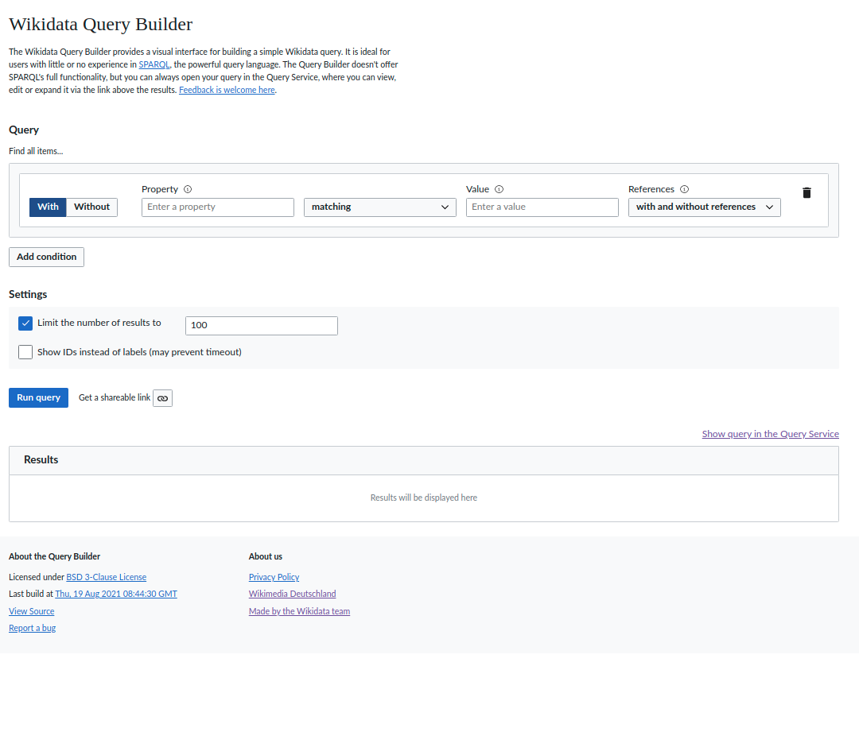
Querying Wikidata
Georgina Burnett
swe_partnerships@wikimedia.de

Slide 11
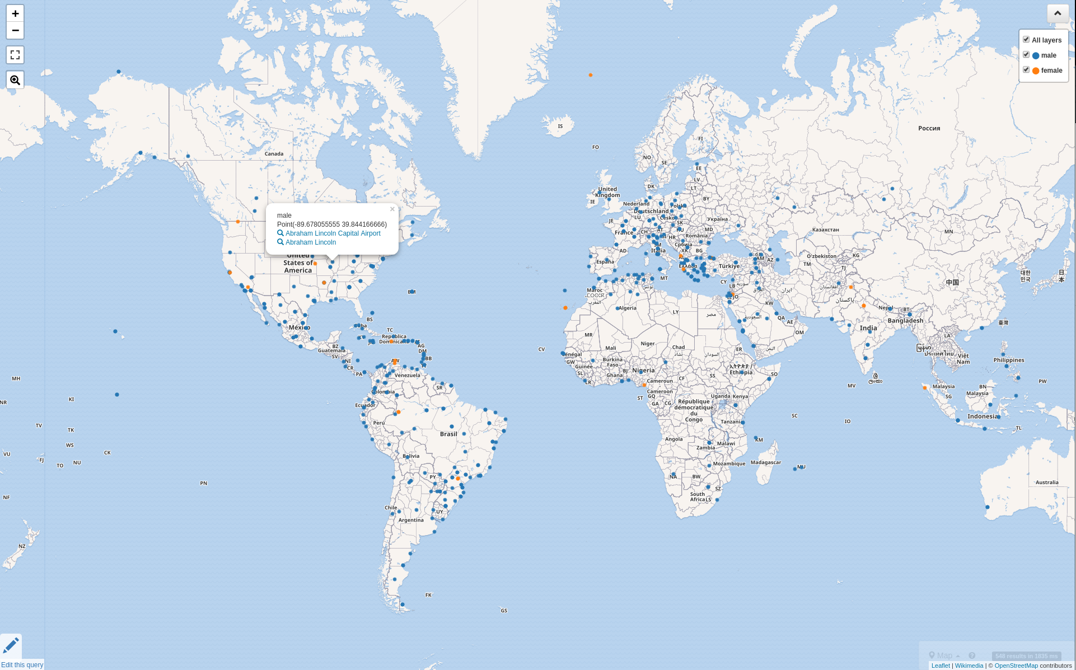
Example query: Airports named after a person, color-coded by gender
Georgina Burnett
swe_partnerships@wikimedia.de

Slide 12
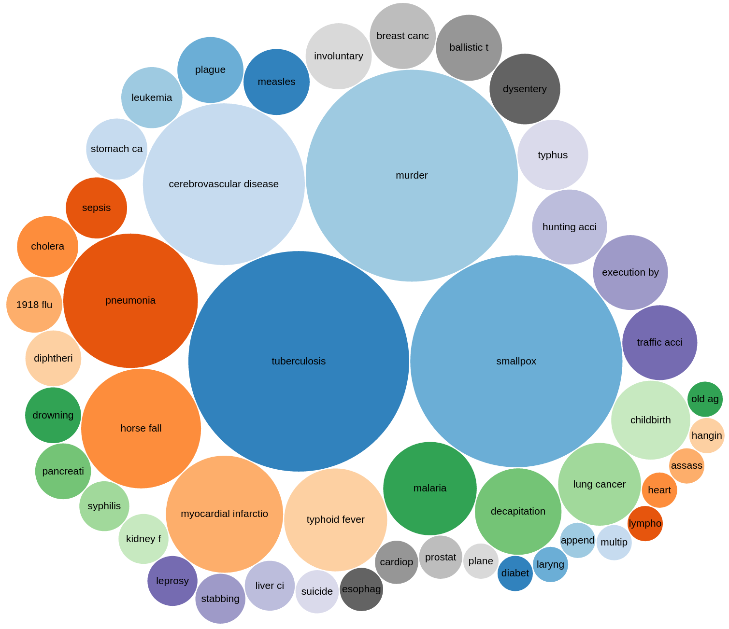
Example query: Cause of death of members of noble families
Georgina Burnett
swe_partnerships@wikimedia.de

Slide 13
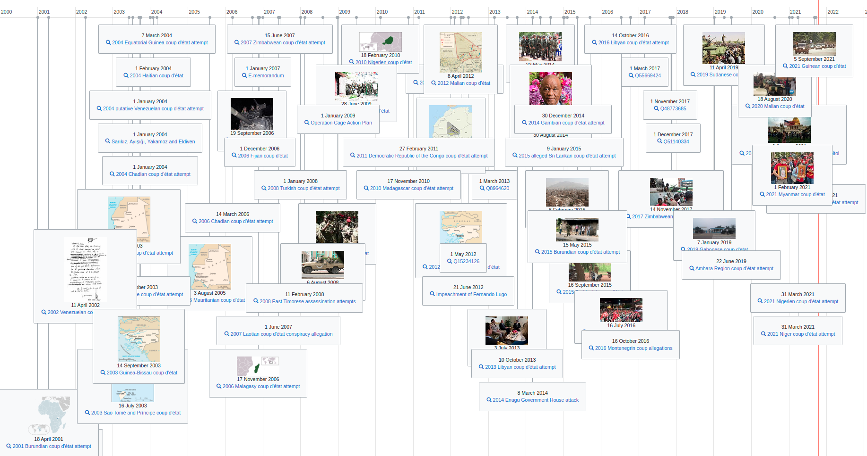
Example query: timeline of coups d’etat during the 21st century
Georgina Burnett
swe_partnerships@wikimedia.de

Slide 14
So, then, what is Wikibase?

Slide 15
Wikibase is the software underlying Wikidata
It is a free and open source software suite launched in 2012 by Wikimedia Deutschland. We continue to develop and maintain it today.
Wikibase powers Wikidata and increasingly, a wide range of other linked open data projects.
Georgina Burnett
swe_partnerships@wikimedia.de

Slide 16
What does Wikibase offer
Users can create and manage their own linked open knowledge base
Its flexibility allows users to build their own data model to suit their needs
A MediaWiki interface means users can easily access and update data
Just like on Wikidata, users can interact with their data using SPARQL, the powerful query language
Georgina Burnett
swe_partnerships@wikimedia.de

Slide 17
Wikibase is ideal for...
Structured data collections that call for a flexible data model
Linking databases to external sources
Collaborative projects where lots of people edit and manipulate data
Data that should be both human and machine readable
Projects involving multilingual labeling
Georgina Burnett
swe_partnerships@wikimedia.de

Slide 18
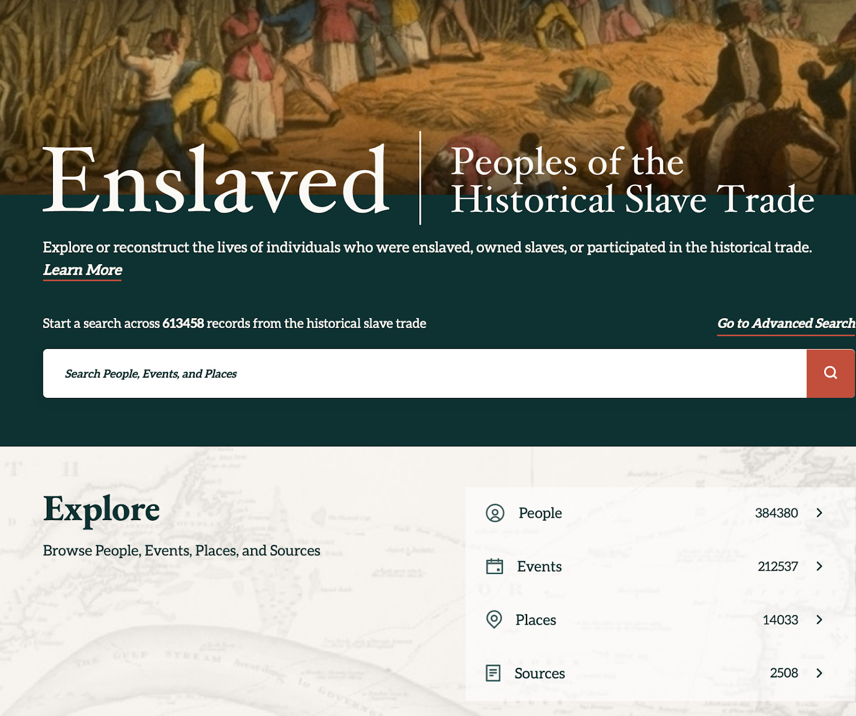
Wikibase in action: Enslaved.org
Enslaved is a linked open database about the history of transatlantic slave trade
Using Wikibase as a linking and reconciliation hub, Enslaved unites seven separate scholarly databases
It contains more than 850 thousand records about (People, Events, Places and sources)
Georgina Burnett
swe_partnerships@wikimedia.de

Slide 19
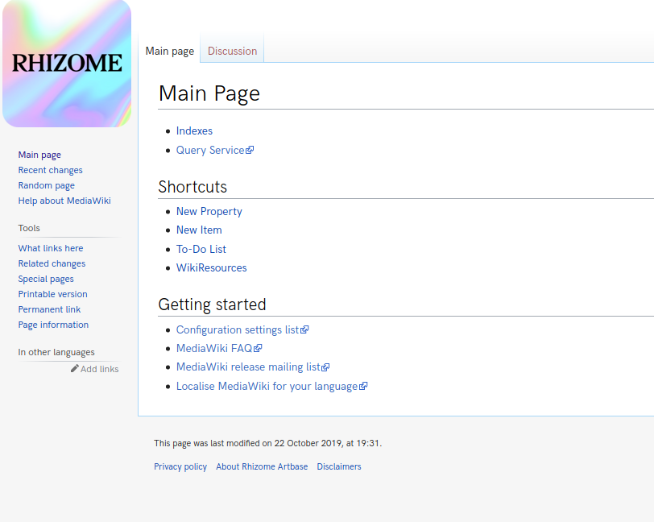
Wikibase in action: Rhizome
Rhizome, an art organization in New York City, was one of the early adopters of Wikibase
Started using Wikibase in 2015 for its archive of born-digital art and digital preservation activities
The flexible model of Wikibase captures the constantly changing nature of digital art
Georgina Burnett
swe_partnerships@wikimedia.de

Slide 20
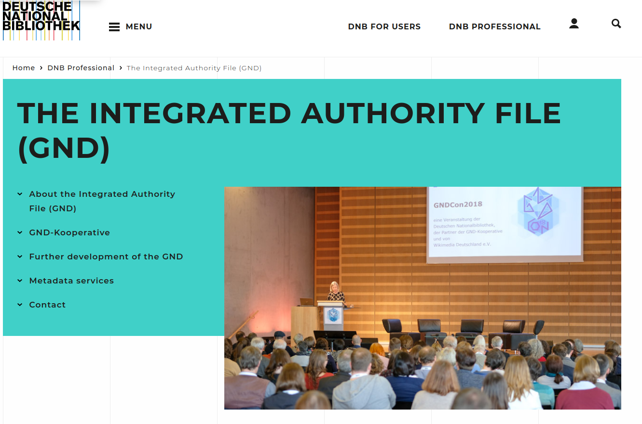
Wikibase in action: German National Library
The German National Library is piloting Wikibase for its integrated authority file
The Gemeinsame Normdatei represents and describes entities then used in cataloguing. It is authoritative across German-speaking countries
The idea is to enable collaborative maintenance of the authority file
Georgina Burnett
swe_partnerships@wikimedia.de

Slide 21
Wikibase and the future

Slide 22
Our vision for Wikibase
“Wikibase makes it easier than ever before to create, connect, and grow a collaborative linked knowledge base. We are enabling the co-creation of the world’s largest knowledge graph of free and open data which will be used to create new knowledge for the world.”
Linked Open Data Strategy 2021*
Georgina Burnett
swe_partnerships@wikimedia.de
*Read our linked open data strategy here https://meta.wikimedia.org/wiki/LinkedOpenData/Strategy2021/Wikibase

Slide 23
Federation
The full power of Wikibase will be unlocked when different Wikibases can “talk” to each other, link content, query across instances, and re-use ontologies
All of this falls within the topic of Federation, or federated Wikibases.
Georgina Burnett
swe_partnerships@wikimedia.de

Slide 24
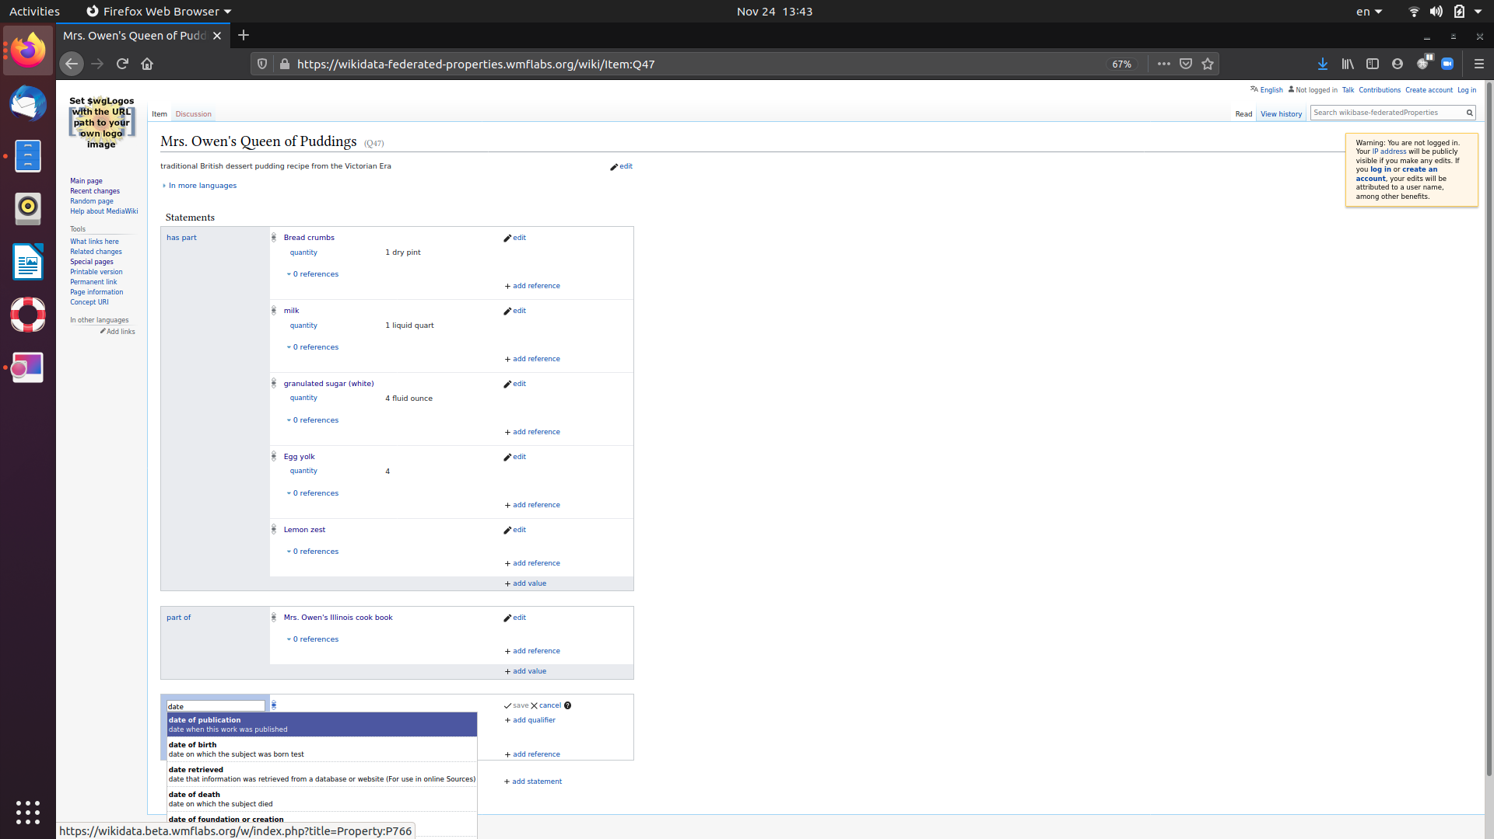
Step 1: Federated properties
Local item in a custom Wikibase
We have taken the first step towards federation: federated properties.
This allows a newly created Wikibase instance to adopt properties from an existing Wikibase instance.
This could be Wikidata, or any other instance.
Properties directly from Wikidata (no local properties are possible)

Slide 25
Federated properties v2
Local item in a custom Wikibase
There are some limitations to the existing federated properties feature.
This year, we have spent time improving the feature. These improvements will make it possible to mix properties from another Wikibase instance, such as Wikidata, with local properties in your Wikibase instance.
Properties directly from Wikidata or own local properties

Slide 26
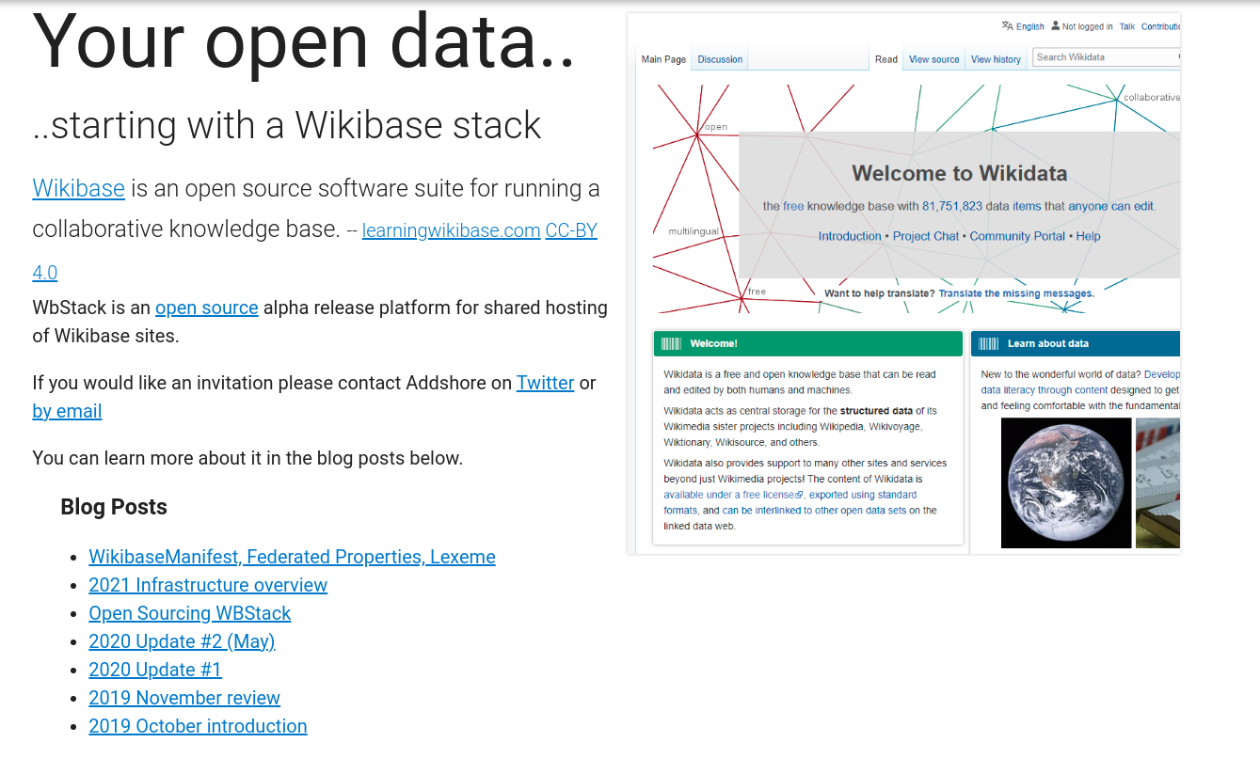
Wikibase.cloud
Wikibase.cloud is a new platform based on WBstack code, but managed and maintained by Wikimedia Deutschland.
It is a “Wikibase as a service” platform that will offer open knowledge projects a new way to create Wikibases quickly and easily.
The new service will launch in early 2022.
Georgina Burnett
swe_partnerships@wikimedia.de
Notes:
Its designed to help non-technical users set up a Wikibase instance quickly.

Slide 27
Joining the Wikibase community
The Wikibase user community continues to grow. Whether to remain informed about our continued work with Wikibase.cloud or to engage with other community members, there are a number of avenues to connect with the community:
  Wikibase Community User Group
  Mailing list
  Telegram channel
  Monthly Live Sessions
Georgina Burnett
swe_partnerships@wikimedia.de

Slide 28
Joining the Wikibase community
Further support resources are available on mediawiki.org, including detailed documentation on how to set up Wikibase using the docker images or manually. You can also find a useful FAQ https://www.mediawiki.org/wiki/Wikibase
If you need technical support, we maintain a space where third party support providers can list their services https://meta.wikimedia.org/wiki/Wikibase/Consultants_and_Support_Providers
Georgina Burnett
swe_partnerships@wikimedia.de

Slide 29
Contact us
If you see the potential for a Wikibase project in your area of work, please feel free to reach out to us in the partnerships team.
We would be happy to have a chat about your project idea, and see how we could help.
You can reach us at swe_partnerships@wikimedia.de
Georgina Burnett
swe_partnerships@wikimedia.de

Slide 30
The EU Knowledge Graph..

